Slide 1
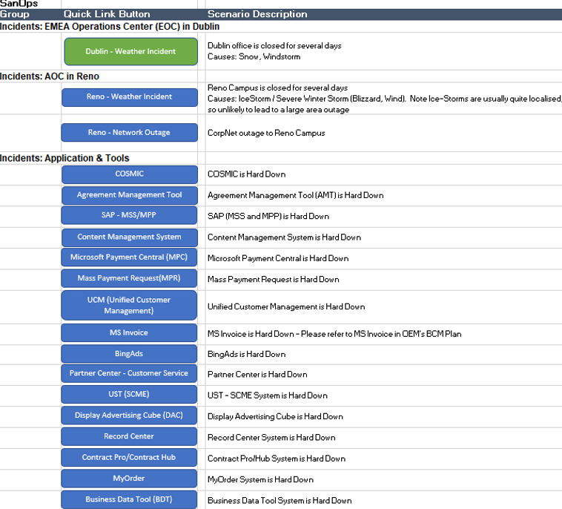
Business Continuity Management Plan - SANOps
Business Need
SANOps business group (Search, Advertisement, News Operations under Microsoft online Inc), team was working to develop a business continuity management (BCM) plan. SANOps operation relies on several Microsoft critical and global applications like Microsoft Payment Central, Invoices, SAP, BingAds and many more. SANOps business team reached out to Affirma to create a BCM plan for their entire business support. The timeline was 2 months starting Feb 2020 and with a hard-due date of March 31, 2020. This involves reaching out to their internal MSFT support teams all over the world, get their BCM plans if any or with their DR plans and else through their SLA documents, discuss with vendor support for SANOps, review, analyze, and create the BCM plans for all their applications.
What We Did
Affirma put together a one (1) person team dedicated with 50% of the time for two months. This also included travel to MSFT Reno/Redmond/Bellevue offices
Affirma quickly jumped into action by collecting all the application details and their level of dependency to SANOps operation. This was tabulated, discussed and agreed upon with the SANOps business team.
Affirma drafted an email template for reaching out to application owners to get the information needed for this BCM creation. Several meetings were scheduled between Affirma member and different MSFT teams.
Affirma continuously worked with Application owner and SANOps business to generate the BCM plan. Also followed Microsoft Business Organization (MBO) BCM template. Since this happened during heightened awareness due to the COVID-19 pandemic, Affirma worked on the review and finalization of the SANOps Pandemic BCM plan and finalized the same for immediate implementation.
Affirma completed the BCM plan, reviewed with the SANOps business team, worked with MBO team to get it approved and finalized the same on March 31, 2020 to the complete satisfaction of the MSFT client manager.

